Slide 1
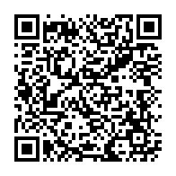



Using Publicity to Encourage Course Materials Reporting at UNC
Follow along!
2026.05.29
Colorado OER Conference
Nancy A. Henke, MA, MLIS
Caterina B. Azzarello, PhD
“Using Publicity to Encourage Course Materials Reporting at UNC” by Nancy A. Henke and Caterina B. Azzarello is licensed CC-BY 4.0
Notes:
Both:
Nancy Henke, Teaching & Learning Librarian with a focus on Open Education at Auraria Library (formerly Textbook Affordability Librarian at UNC)
Caterina Azzarello, Affordable & OER Student Assistant for 2025-26, OER Coordinator at Arapahoe Community College

Slide 2

Presentation Outline
Introduction
Context, Problem
Intervention
Results
Lessons Learned
Discussion
Follow along!
Notes:
Cat

Slide 3

Introduction
Instructors must report all required course materials. Why?
Federal requirements:
Higher Education Opportunity Act of 2008, sec. 133
State requirements: Colorado Revised Statute 23-1-134
Why Is Reporting Course Materials Important?
Ensures compliance with state and federal mandates
Promotes cost transparency
Helps students budget for the upcoming semester
Enables tracking of OER/ZTC and low-cost materials
Supports institution/state planning and advocacy
Notes:
Nancy
· Instructors are required to report all required course materials, including OER, other ZTC materials, and commercial (cost-bearing) resources.
o Why?
§ Federal requirements:
· Higher Education Opportunity Act of 2008, sec. 133
· Requires institutions to disclose in the published course schedule the price of textbooks and supplemental materials for preregistration and registration
§ State:
· Colorado Revised Statute 23-1-134
· Requires public institutions of higher education inform students about which courses and sections use free OER and other low-cost materials.
Why is Reporting Materials Important?

Slide 4

Issues at UNC
Consequences
Delayed reporting (after registration has started)
Incomplete or missing data (no reporting at all)
Inconsistent participation across colleges and departments
Reduced transparency for students
Barriers to affordability efforts
Limited ability to assess OER/ZTC impact
Challenges in institutional decision-making
Notes:
Cat
Examples of inconsistent participation across colleges and departments: Library faculty reported course materials at 91%, College of Natural and Health Sciences was 57%)

Slide 5

Barriers to Timely Reporting
Formal study forthcoming FA26
Anecdotally:
  Time constraints/workload
  Emails go to inbox doom
  Faculty don’t have teaching assignments yet
  Faculty not yet hired for certain sections
  Confusion about reporting process and systems
  Emails to Bookstore with materials receive no response/no update in system
  Not understanding timeline (why so early?)
Notes:
Cat

Slide 6
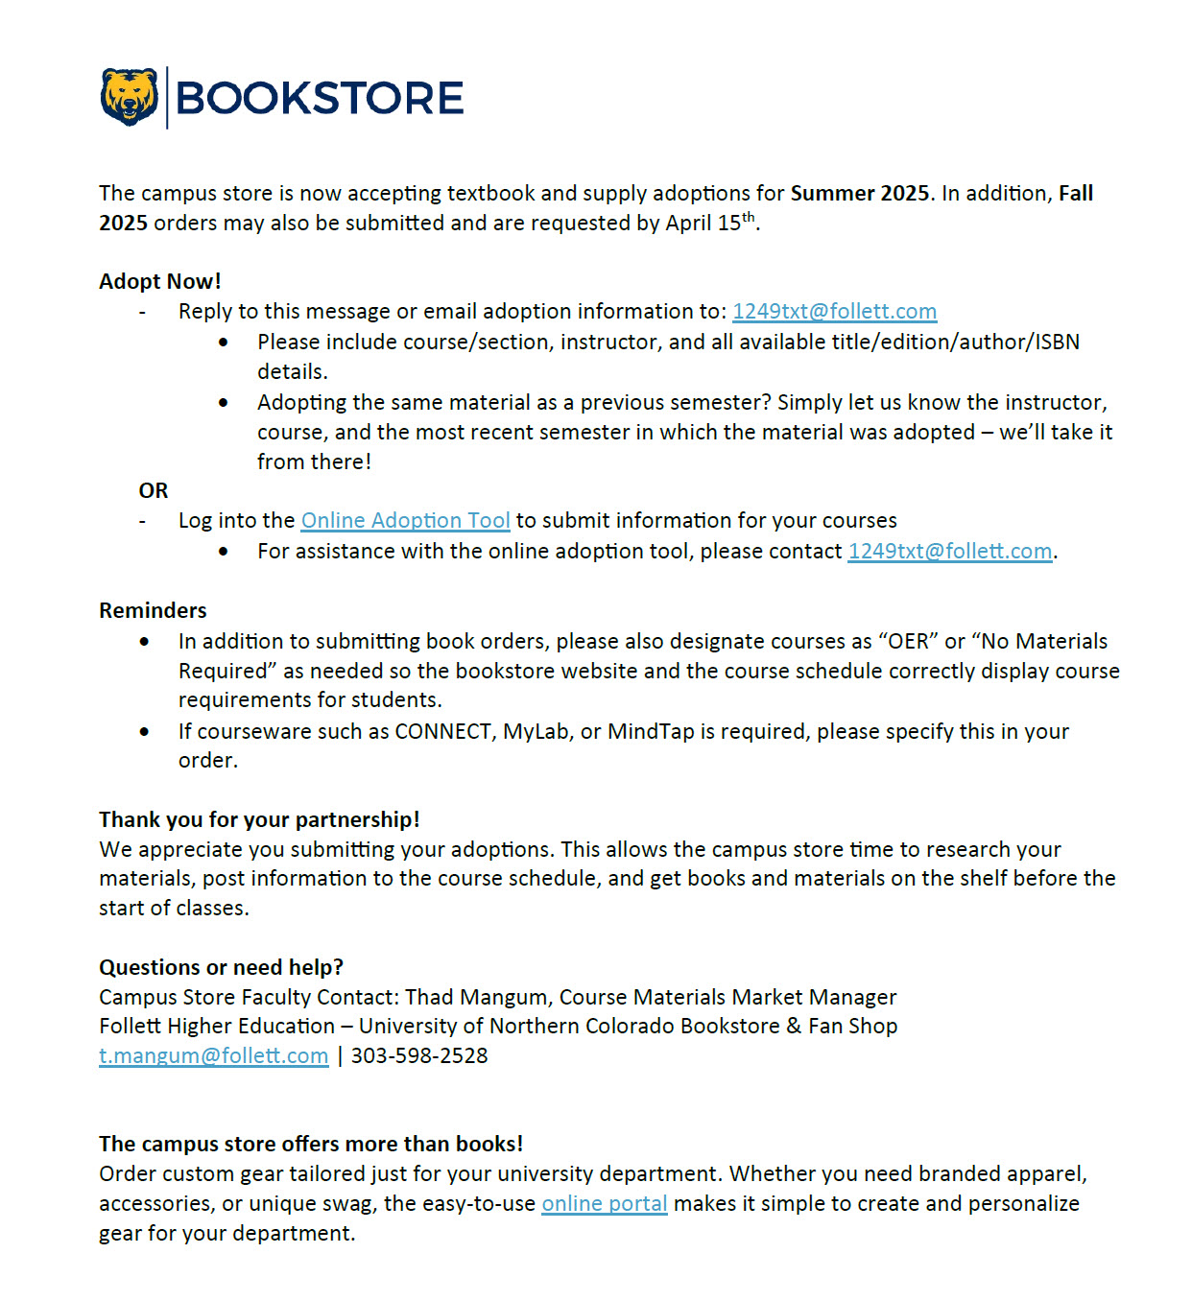
Prior to Intervention
Sometimes inconsistent, often confusing
Email from Bookstore (Follett) prior to due date
Possible (?) follow-up from Follett as reminder
Faculty must:
  email the Bookstore with materials needed OR
  use online adoption tool (which doesn’t always work)
Counterintuitive for zero-cost materials
Bookstore defaults to previously used materials in the absence of new information
Notes:
Nancy

Slide 7
Intervention: SP25
“Top down” email communication
Course Marking and Assessment Subcommittee of AOER Committee
  Worked with Associate Provost to improve communication to deans
  Developed emails from Associate Provost to deans to encourage reporting in their colleges
    Focus on WHY, WHY NOW, and HOW
  Implemented in SP25
  Then Associate Provost left her position
  AOER Committee had no relationship with new person.
What now?
Notes:
Nancy

Slide 8
Intervention: FA25
“Bottom up” publicity campaign
Developed by Textbook Affordability Librarian and Affordable & OER Student Assistant
Goal: increase reporting participation
Focus on awareness and engagement
  Targeted communication to faculty
  Clear explanation of reporting importance
  Emphasis on student impact
  Timeline outreach before semester deadlines
Notes:
Cat

Slide 9
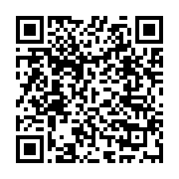
Intervention: FA25 (continued)
Publicity campaign:
  Announcements in multiple newsletters
    Academic Affairs newsletter
    Center for the Enhancement of Teaching and Learning newsletter
    Around UNC (University newsletter)
  Email to the Friends of AOER list (~150+ campus OER supporters)
  Slides on campus screens
This folder has all the publicity items
Notes:
Cat

Slide 10

Examples of Publicity
Notes:
Nancy

Slide 11

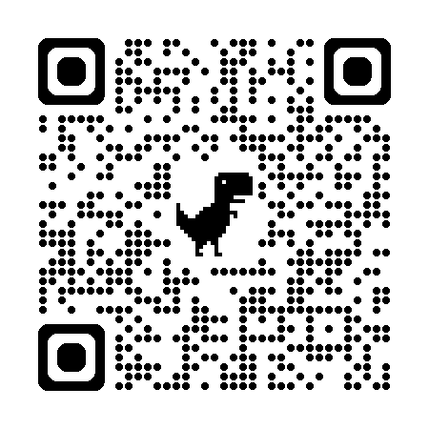

Instructors: Report Your Course Materials for SP26!
Help students plan and budget for next semester.
Learn more
Notes:
Nancy

Slide 12
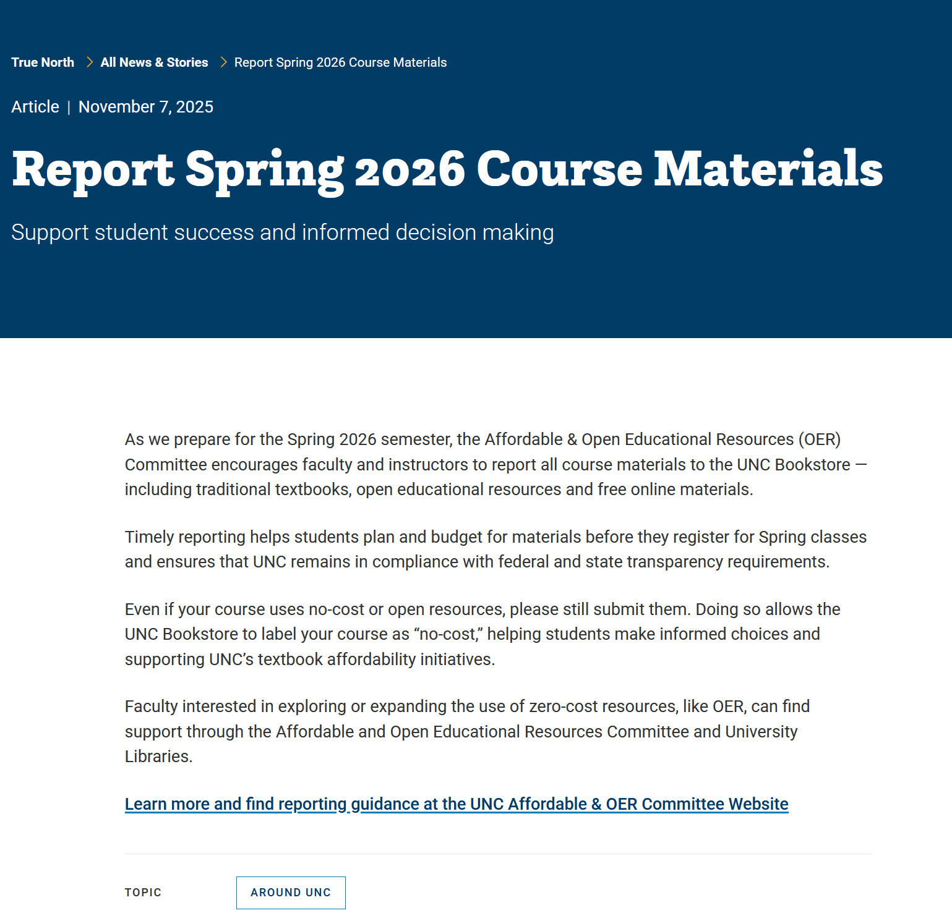
Examples of Publicity, continued
Around UNC Announcement, Nov. 7, 2025
Notes:
Nancy

Slide 13

LibGuide with Course Marking Information
Course Markings LibGuide page
Notes:
Nancy

Slide 14

+34.83%
Results of Pilot
Improved reporting rates
+34.83% increase from FA25 to SP26 (based on the Sunday before classes began)
Increased faculty awareness
More complete course materials data
Evidence of effectiveness
Notes:
Cat

Slide 15
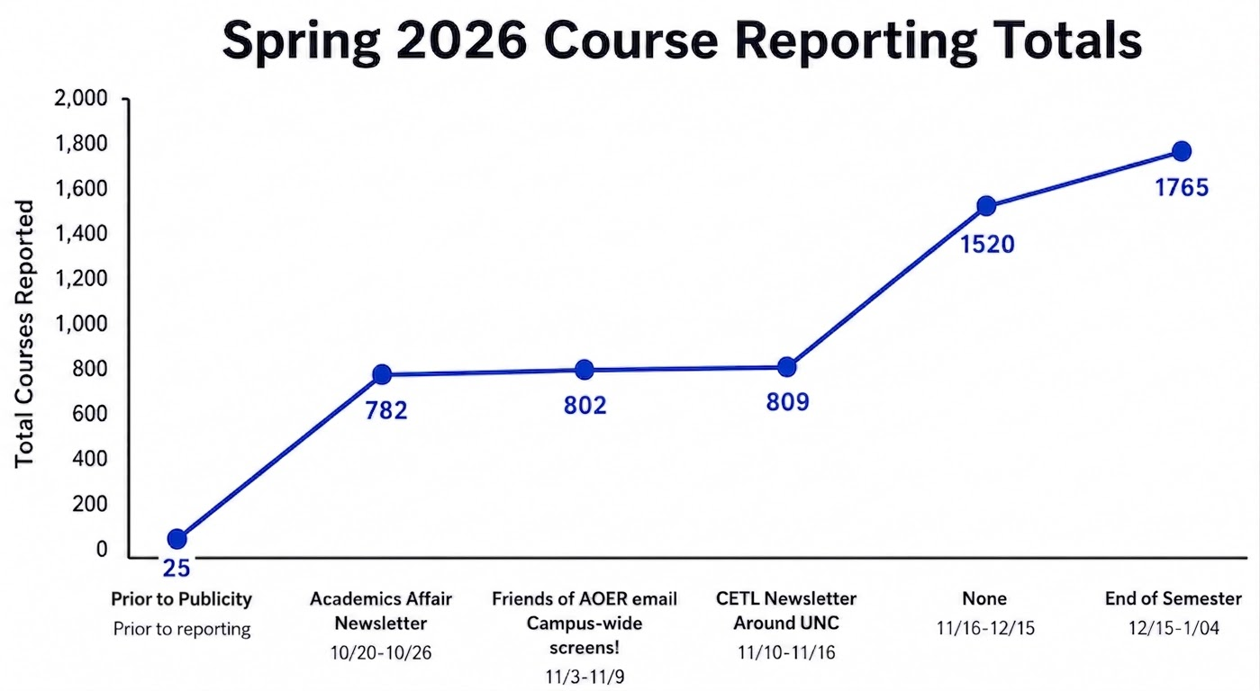
Graph of Spring 2026 Course Reporting Totals
Notes:
Nancy

Slide 16

Lessons Learned
Timing is critical
Using different outlets helps
Messaging should be:
  Clear
  Purpose-driven (WHY)
  Largely student-focused
Small interventions can produce meaningful change
Notes:
Cat

Slide 17

We are Curious…
What strategies have worked at your institution?
How can reporting processes be improved?
Do you have any new ideas for increasing faculty reporting?
Notes:
Nancy

Slide 18

THANK YOU!
Nancy A. Henke: nancy.henke@ucdenver.edu
Caterina B. Azzarello:
caterina.azzarello@unco.edu

